Slide 1


Welcome to my presentation

Slide 2
Presented by:
Tamanna Akter
Id: 221-15-5298
Section: 61_M
Presented to:
Md. Zahim Hassan
Lecturer, CSE, DIU

Slide 3

Contents:
Problem Statements
Solutions
My Application's name & Logo
Features
Technology used
Market size
Target consumer
Revenue Generation Strategies
Market Strategies
Competitors
Challenges
Impact and Future Outlook

Slide 4
Problem Statements:
Need more response Time and Accessibility.
Not User-friendly Interface.
Unavailability of accurate Information
Unavailable offline Functionality.
Insufficient integration with Emergency Services.
Limited Awareness.

Slide 5
Solutions:
1. Fast response and accessibility.
2. Easy and Simple interface.
3. Sufficient accurate and relative information.
4. Available in both offline and online.
5. Added sufficient emergency services.
6. Realtime updates of awareness.

Slide 6

My Application's name & Logo:
First aid is better than Last!
AidSwift

Slide 7

Features :
Videos, Animations.
First aid course
Doctor appointment
Simple step-by-step skill guides
Specialist physicians in your area
Alarm for medication doses
Household and First Aid Kit
Useful tips ,Emergency Services.

Slide 8
Technology used
Programming Languages:
Swift (iOS)
Java (Android)
Development Frameworks:
React Native
Flutter
Backend Development:
Node.js, Firebase
Database:
SQLite, MySQL

Slide 9
Market size
In Bangladesh:
USD 442 million in June 2020
USD 820 million in 2025, growing at a CAGR of 13%.
Worldwide:
USD 4.38 billion in 2022
growth rate (CAGR) of 4.40% from 2023 to 2030.

Slide 10

Target consumer:
General Public
Students
Travelers, Tourists, Caregivers
Workplace and Industrial Settings
Community Organizations
First Responders
Healthcare Professionals
Educational Institutions

Slide 11
Revenue Generation
Strategies:
▪ First aid courses.
▪ Partnership and Collaborations
▪ Data Licensing
▪ By selling various first aid equipment.
By providing some paid services By showing ads

Slide 12
Market
Strategies:
Easy to use.
Freemium Model with Premium Features.
Regular Updates and Improvements
Partnerships with Emergency Services.
Localization.
Low cost.

Slide 13





Competitors:

Slide 14
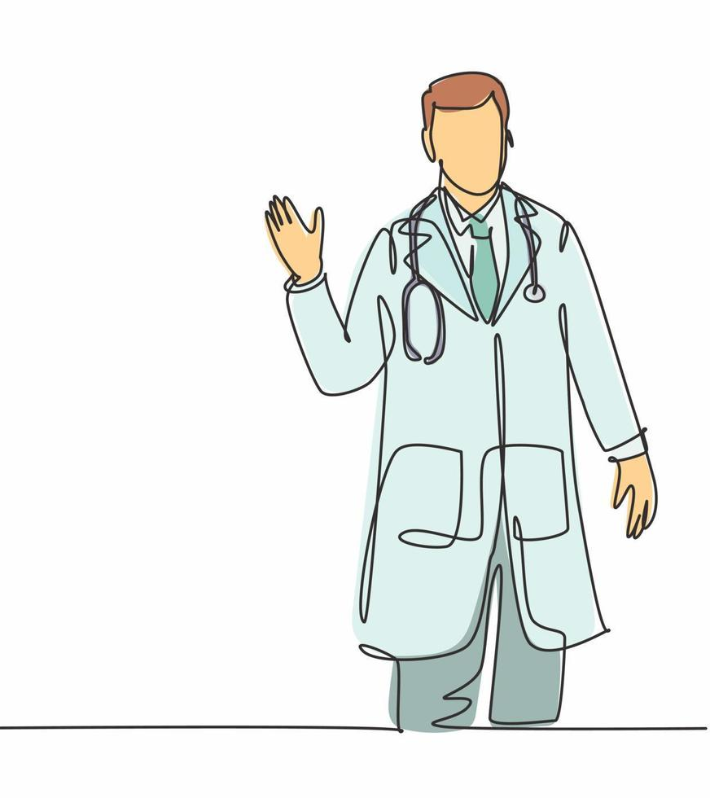
Challenges :
Competition
Language limitations.
Need regular Update.
Some technical errors.
Marketing costs high.
Keep up with market trends
Implementing AI and IoT
Required mid and high configuration device.

Slide 15
Impact and Future Outlook:
people will aware about fast aid using this app.
No need to go to the hospital for small injuries.
The risk of death is reduced.
People's awareness will increase.
Premature mortality will decrease.
Child and women mortality will decrease.

Slide 16


